Slide 1
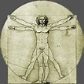
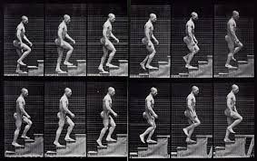
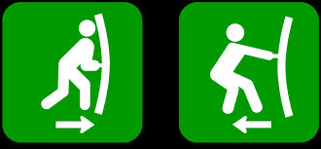
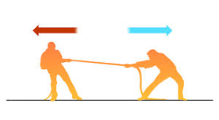
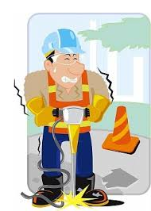
GWEN’S CONCEPTUAL DESIGN APP II
WISHA Caution/Hazard Checklist
WISHA Caution/Hazard Checklist
NIOSH, REBA, Strain
Moore-Garg Strain Index, Roger's Muscle Fatigue Assessment
Liberty Manual Psychophysical Tables
NIOSH Lifting Equation, WISHA Lifting Calculator
Moore-Garg Strain Index
ACGIH TLV Hand Arm Segmental Vibration
RULA and Moore-Garg Strain Index
MMH
UET
Never assessed a risk?
SUGGESTIONS
NIOSH, REBA, Strain Index
Liberty Manual Psychophysical Tables
NIOSH Lifting Equation, WISHA Lifting Calculator
Moore-Garg Strain Index, Roger's Muscle Fatigue Assessment
Moore-Garg Strain Index
ACGIH TLV Hand Arm Segmental Vibration
RULA and Moore-Garg Strain Index
repetitive action?
repetitive action?
pushing or pulling?
force?
NEITHER
vibration?
NEITHER

